Slide 1
Antineoplastic
Traditional Agents
Antimetabolites
Purine Analogues
Mercaptopurine
Pyrimidine Analogues
5-FU
Gemcitabine
Capecitabine
Cytarabine
Floxuridine
Folate Antagonist
Methotrexate
Pemetrexed
Alkylating Agents
Classical Alkylating Agents
Nitrogen Mustards
Nitrogen Mustard
Melphalan
Cyclophosphamide
Ifosfamide
Nitrosoureas
Carmustine
Non-Classical Alkylating Agents
Procarbazine
Dacarbazine
Temozolomide
Alkylating-Like Platinum Compounds
Cisplatin
Carboplatin
Oxaliplatin
Plant Alkaloids
Vinca alkaloid
Vincristine
Vinblastine
Vinorelbine
Taxanes
Paclitaxel
Docetaxel
Enzyme inhibitors
Topoisomerase 1 Inhibitor
Irinotecan
Topotecan
Topoisomerase 2 Inhibitor
Etoposide
Anthracyclines
Doxorubicin
Daunorubicin
Idarubicin
Epirubicin
Mitoxantrone
Antitumor Antibiotics
Mitomycin
Bleomycin
Targeted agents
Monoclonal Antibodies (Mab)
Lymphocyte Antigens
Alemtuzumab
Ibritumomab Tiuxetan
Rituximab
HER-2 neu
Trastuzumab
Lapatinib
EGFR inhibitors
Cetuximab
Panitumumab
VEGF
Bevacizumab
Tyrosine Kinase Inhibitors
Sorafenib
Sunitinib
Dasatinib
Nilotinib
Imatinib
M-TOR Inhibitors
Endocrine
Endocrine Agonist
Megestrol
LHRH Analogs
Goserelin
Leuprolide
abarelix
Androgens
Endocrine Antagonist
SERMS
Tamoxifen
Toremifene
Fulvestrant
Anti-androgens
Bicalutamide
Flutamide
Nilutamide
Aromatase inhibitors
Anastrozole
Letrozole
Exemestane
Antineoplastic Classification
Notes:
Gonadotropin-releasing hormone (GnRH), also known as Luteinizing-hormone-releasing hormone (LHRH) and luliberin

Slide 2
Endocrine Antagonist
SERMS
Tamoxifen
Toremifene
Fulvestrant
Anti-androgens
Bicalutamide
Flutamide
Nilutamide
Aromatase inhibitors
Anastrozole
Letrozole
Exemestane

Slide 3
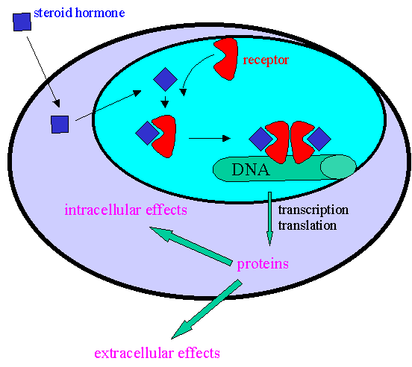
SERMS | Use | Dose | S/E | S/E Tx
Tamoxifen (Nolvadex) | Breast cancer Prevention | 20 mg daily | Hot flashes → Moody → Thromboembolism → | Gabapentin Venlafaxine Eliminate other risks
Toremifene (Fareston) |  |  | “ “ | “ ”
Fulvestrant (Faslodex) | Metastatic breast cancer IM only |  | Hot flashes Nausea Hot flashes Insomnia Depression

Slide 4
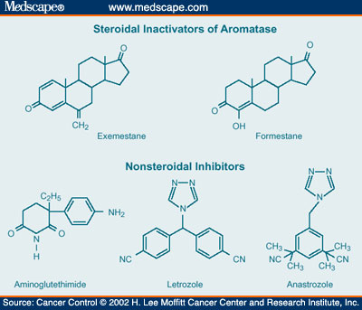
Receptor antagonists for testosterone on the prostate cancer cells
Anti-Androgen | Use | S/E
Bicalutamide Flutamide Nilutamide | Prostate cancer | Loss of libido Hot flashes

Slide 5
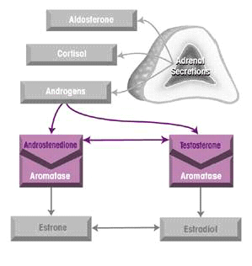
Aromatase Inhibitor: Inhibits conversion of adrenal androgens to estrogen.
Aromatase Inhibitor | Use | S/E
Anastrozole (Arimidex) | Breast Cancer | Weight loss Bone loss Mood
Letrozole (Femara) | Breast Cancer | “ “
Exemestane (Aromasin) | Irreversible Inhibitor for Breast Cancer | “ “

